Slide 1


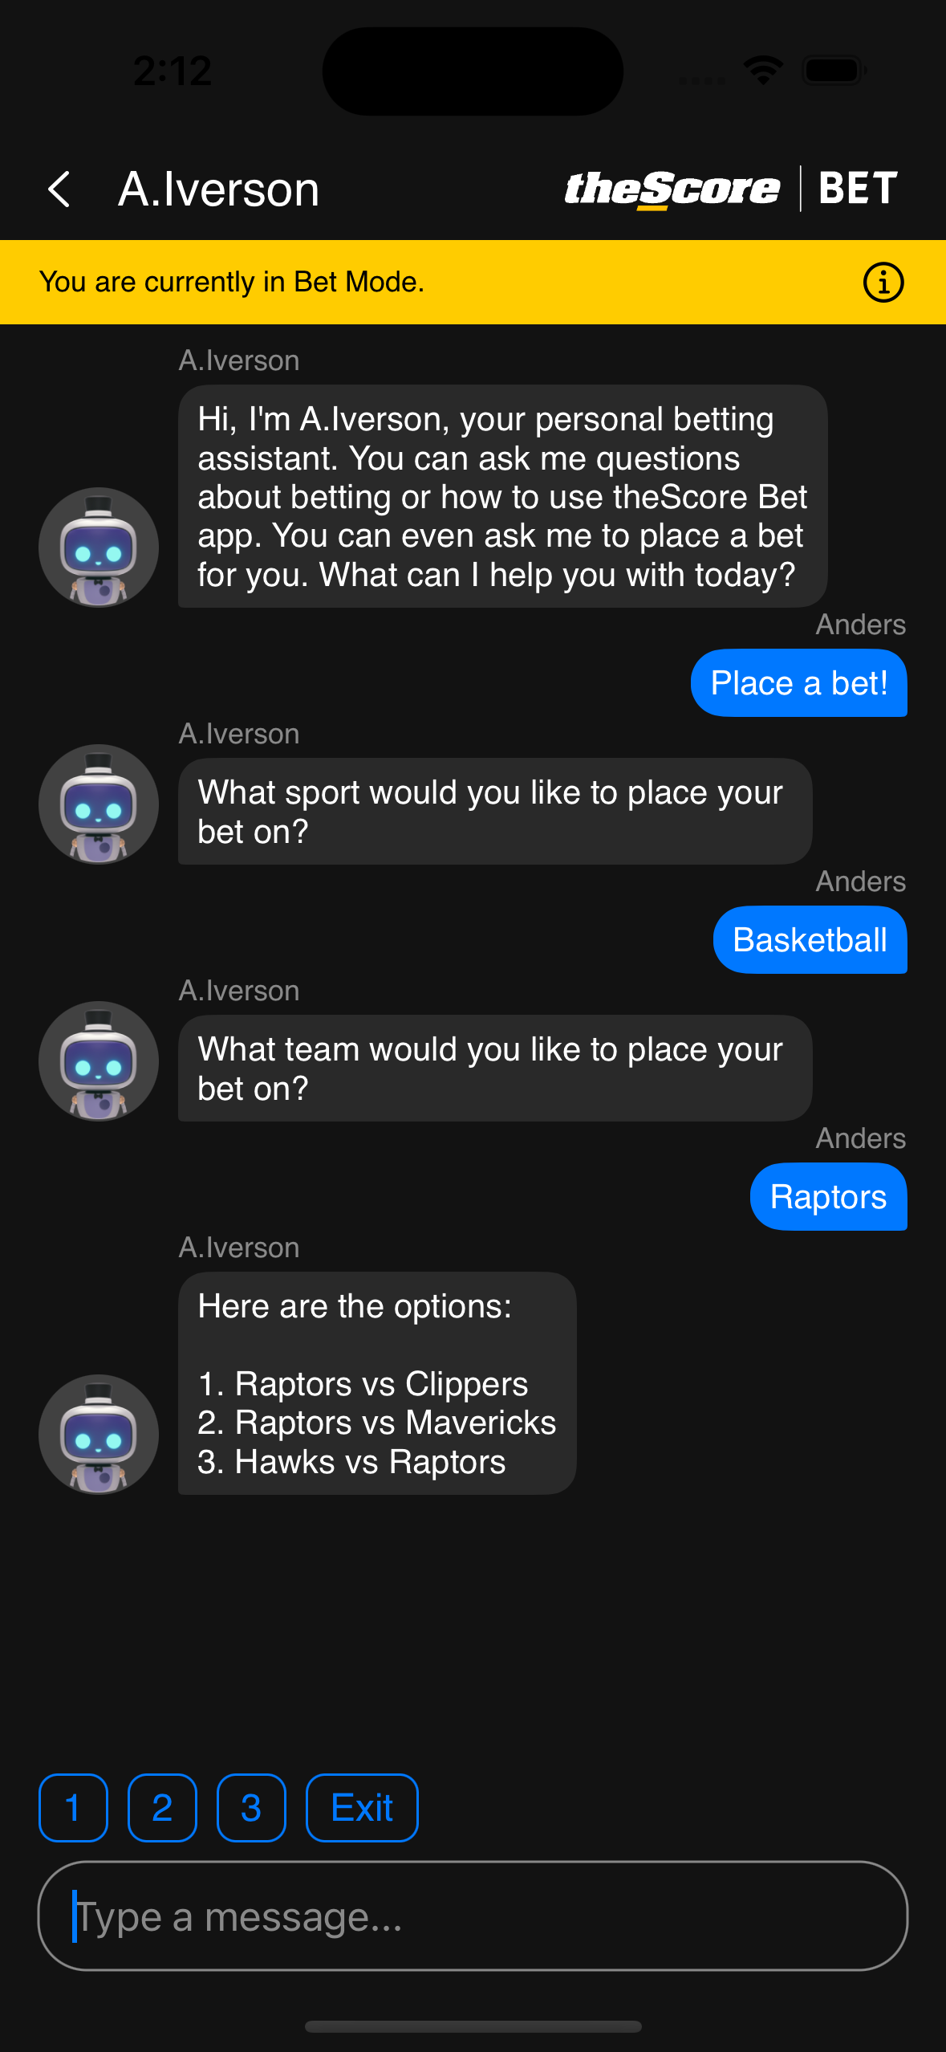

SUMMER 2023 CO-OP HACKATHON
TEAM CO-OPPENHEIMER
YOUR BET, YOUR WAY. JUST A CHAT AWAY.
A.IVERSON

Slide 2
SUMMER 2023 CO-OP HACKATHON
TEAM CO-OPPENHEIMER
MISSION STATEMENT
To help lower the barrier of entry into sports betting, educate users, and encourage responsible gambling.

Slide 3

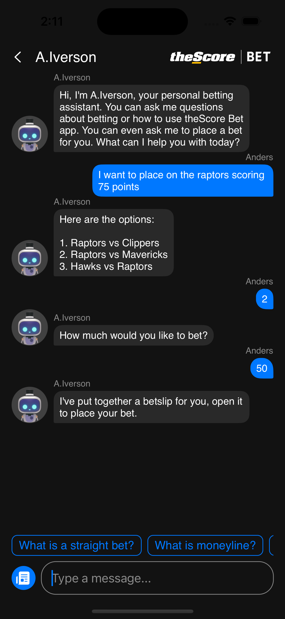




SUMMER 2023 CO-OP HACKATHON
TEAM CO-OPPENHEIMER
INTRODUCING
A.IVERSON
YOUR PERSONAL BETTING ASSISTANT

Slide 4


SUMMER 2023 CO-OP HACKATHON
TEAM CO-OPPENHEIMER
PROBLEM STATEMENT + SOLUTION
Issues new betters may experience
Unfamiliar with betting
Answers betting related questions/terminology
Offers risk management strategies to encourage safe betting
App Navigation
Instructions on placing bets
Interactive tutorials
Place bets through A.Iverson

Slide 5
UX RESEARCH
POTENTIAL IMPACT AREA
Withdrawal methods FAQ
 | 2022 Q4 | 2023 Q1
# of related CX tickets
433
418
Question: Can we use A.Iverson to dramatically reduce the number of CX tickets around common FAQ or navigation questions?

Slide 6
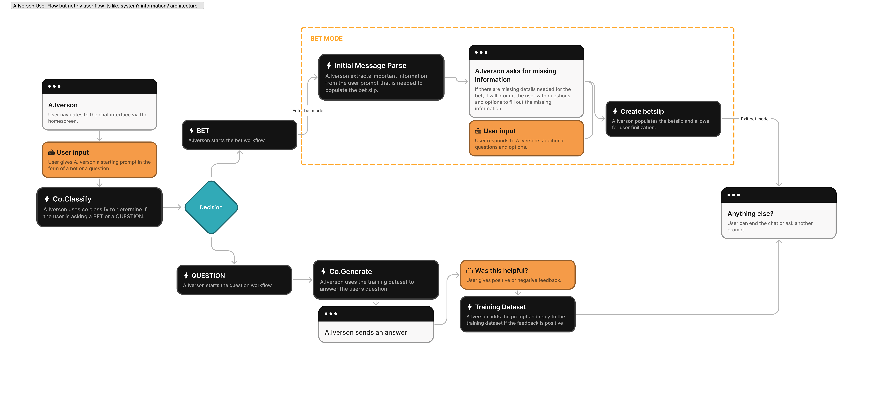
USER FLOW/INFORMATION ARCHITECTURE

Slide 7
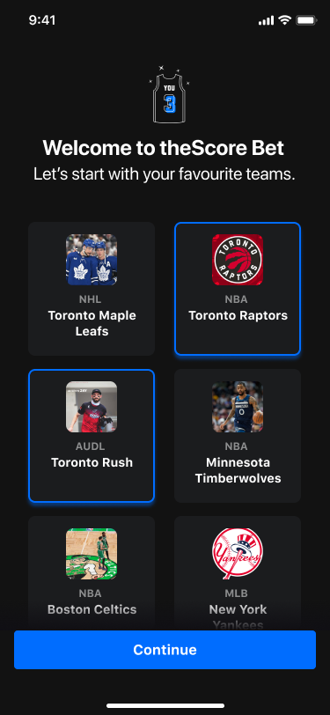
SUMMER 2023 CO-OP HACKATHON
TEAM CO-OPPENHEIMER
ONBOARDING DEMO

Slide 8




SUMMER 2023 CO-OP HACKATHON
TEAM CO-OPPENHEIMER
OUR STACK

Slide 9
SUMMER 2023 CO-OP HACKATHON
TEAM CO-OPPENHEIMER
CHATBOT
DEMO

Slide 10
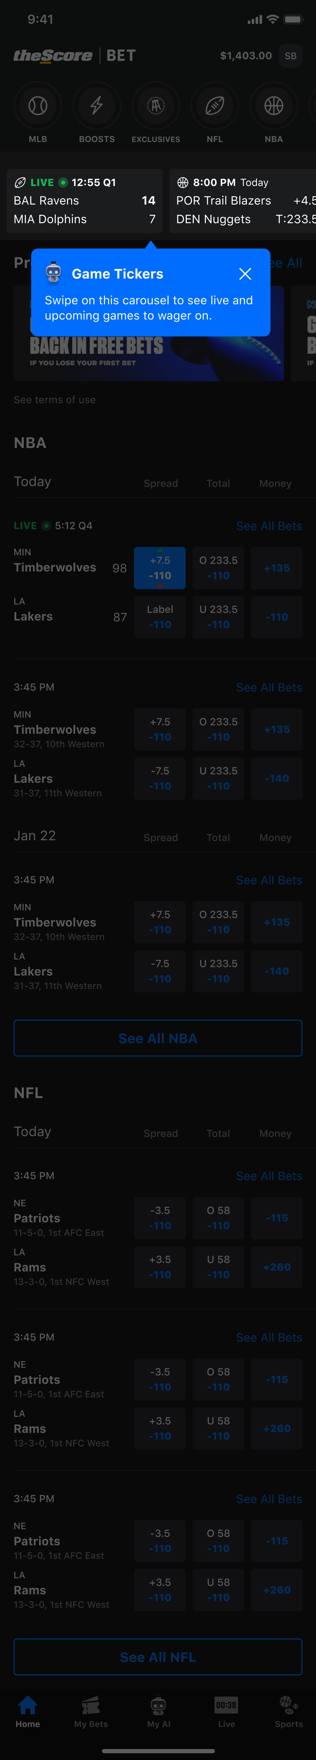




SUMMER 2023 CO-OP HACKATHON
TEAM CO-OPPENHEIMER
Next Steps
Larger training datasets
Expand interactive tutorials
Train models on risk management
Observe chatbot analytics

Slide 11




Measures of Success
NEW USER RETENTION RATES
CONVERSATION LENGTH /
ENGAGED CONVERSATIONS
BETS CREATED
USER FEEDBACK

Slide 12
SUMMER 2023 CO-OP HACKATHON
TEAM CO-OPPENHEIMER
THANK YOU!
ZAN QURESHI | KELLY PHAM | ANDERS TAI | KAIFEE HAQUE | PHOEBE WANG

Slide 13
SUMMER 2023 CO-OP HACKATHON
TEAM CO-OPPENHEIMER
APPENDIX

Slide 14
SUMMER 2023 CO-OP HACKATHON
TEAM CO-OPPENHEIMER
WHAT IS COHERE AND WHY DID WE USE IT?
Cohere
Cohere is an AI platform that gives businesses and developers access to NLP capabilities. Cohere's models give applications interactive chat features, by understanding and generating. Businesses can use Cohere to build large scale natural language processing models.
Why did we use Cohere?
We used Cohere because it offered easy-to-use APIs that we could apply within the short span of our hackathon. More specifically, the Generate and Classify APIs fit the needs of our hackathon idea. We were able to use Classify to identify the type of request a user is making (question or bet) and the generate API to train a model on data about theScore. When asked a question about theScore, the trained model will be able to generate text and answer the user's question about theScore Bet.
MARKET SHARE
$800M

Slide 15
SUMMER 2023 CO-OP HACKATHON
TEAM CO-OPPENHEIMER
HOW DID WE BUILD OUR APP?
NLP/Cohere APIs
We first used the Classify API and trained it to recognize if a user's message is a bet or a question. For questions, we trained a custom language model on answers to questions about the app such as "How do I place a bet on theScore" as well as general betting concepts like "What is a parlay?". The model would then generate text based on the training data we fed in.
For bets, we trained models to extract certain data from a user's message. We have models trained to extract team name, bet outcome, and game outcome. When the user places a bet through the chatbot, these values will be extracted from the message and the bet slip will be created using this information.
Frontend/Backend
We used Swift for our frontend and Python for our backend. When the user sends a message, the app sends a JSON object to the backend. We used FastAPI to create an API endpoint which receives this object. Once the message hits the backend, it calls the endpoints to our Cohere models to parse the user's message. We then use the response to send a JSON object back to the frontend that includes the bet data or the answer to the user's question. We also send back flags to the frontend to indicate what to display such as the "Bet Mode" banner and suggested prompts.
MARKET SHARE
$800M

Slide 16
CHATBOT DEMO VIDEO
https://drive.google.com/file/d/1q3VXngbny1PqluJ0LtecFoIC3bGs4crV/view?usp=sharing
ONBOARDING DEMO VIDEO
https://drive.google.com/file/d/1czd7tflDsznlaibTrT02JpO92CUzNP3k/view?usp=sharing
MARKET SHARE
$800M

Slide 17
USER FLOW
https://www.figma.com/file/L4MDP4jF3zuXjXoF18RUTz/hackathon-user-flow?type=whiteboard
MARKET SHARE
$800M

